Slide 1

Real-Time Human Count And Social Distance Detection in Covid Pandemic Using Deep Learning
Project Guide: Prof. Sunil Katkar
Group Members: Salman Ansari, Parth Desai, Hitesh Gosavi

Slide 2

PRESENTATION OUTLINE
Abstract
Introduction
Literature Review
Methodology
Implementation
Result
Conclusion
References
SWOC Analysis

Slide 3
Abstract
To minimize the effects of the coronavirus pandemic, we provide a social distance detection system that uses deep learning techniques to measure distance between individuals.
By analyzing video feed, detection techniques are intended to alert people to keep a safe distance from one another. A pre-trained open-source object detection model is applied for human detection, with the video as input. A pair of violators is displayed with a red frame.
A video of people on the street is being used to validate the proposed strategy. The proposed method can be used to calculate the social distance between multiple individuals in a video.

Slide 4
INTRODUCTION
The chaotic world situation caused by the SARS-CoV2 virus (COVID-19 pandemic) has hampered many sectors of human activity, especially in activities that require physical interactions. Thus, requiring social restrictions for those sectors that are affected.
So, this presentation reports analysis of different proposed systems by studying different research papers.
Different papers related to social distance detection and human counting systems have been studied and detailed analysis is reported

Slide 5
LITERATURE REVIEW
Sr no | Authors | Name | Year | keyword | methodology | outcome | conclusion
1 | Muhammad Lanang Afkaar, Sulthan Muzakki Adytia | A computer vision-based object detection and counting for COVID-19 protocol compliance: a case study of Jakarta | 2021 | Covid-19, Smart mobility | Python program Object counting Large scale social restriction violation detection | The results of object counting and physical distancing are expected to be a guideline for public complaint by using several specific location. | The proposed systems are Yolo and Mobile net SSD with 30% and 40% confidence are used. Such condition is not always accurate and can be different from what is happening in the field.
2 | Yew Cheong , Mohd Zafri Baharuddin | Social Distancing Detection with Deep Learning Model | 2020 | Social distancing, Pedestrian detection | Pedestrian detection Camera view calibration Distance measurement | The proposed method was validated using a video showing pedestrian walking on a street. | The proposed method is capable to determine the social distancing measures between people.

Slide 6
LITERATURE REVIEW
Sr no | Authors | Name | Year | keyword | methodology | outcome | conclusion
3 | Prof. B. Sathyabama, Ashutosh Devpura | Monitoring Pandemic Precautionary Protocols using Real-time Surveillance and Artificial Intelligence | 2020 | Face mask, Artificial intelligence, Tensor flow | Object detection in Tensor flow Implementation of social detecting Face mask detection | For social distancing framework , The calibration of the model by simulating a 3-D depth factor based on the camera position and orientation gives better analysis | The proposed framework can detect social spacing and face covering correctly
4 | Sheshang Degadwala, Dhairya Vyas | Visual Social Distance Alert System Using Computer Vision & Deep Learning | 2021 | Social distancing and image processing | Input frames Object detection and tracking Distance measure Alert system | The proposed research work will discuss about how video social distancing is related with past writing in social signal processing and show a way to investigate new computer vision techniques that can give an answer for such issue. | This paper is concluded with future moves that are identified with the viability of video social distancing frameworks, moral ramifications and future application situations.

Slide 7
LITERATURE REVIEW
Sr no | Authors | Name | Year | keyword | methodology | outcome | conclusion
5 | Jingchen Qin, Ning Xu | Research and implementation of social distancing monitoring technology based on SSD | 2020 | SSD, Object detection, Social distancing monitoring | SSD framework Prior box regression model Dataset making Training Process | SSD object detection algorithm has high accuracy and speed in the application of social distancing monitoring | Model can be deployed on a high performance GPU to further improve real time performance
6 | Antonio Brunetti, Domenico Buongiorno | Computer Vision and Deep learning Techniques for Pedestrian detection and Tracking: A Survey | 2020 | Pedestrian detection and Human tracking | System for pedestrian detection Computer vision methods for pedestrian detection Machine learning techniques for pedestrian detection | A survey on pedestrian detection and tracking system have been presented. Recent adoption of Deep Learning methodologies and in particular of Convolutional Neural Networks for pedestrian detection and tracking deserved a dedicated state-of-the-art survey | For pedestrian detection, the most successful way seems to consist in the combination of Deep Learning with classical Machine Learning models because this seems to imply high levels of accuracy and less computation respect to hand-designed features and classification

Slide 8
METHODOLOGY
The social distancing detection tool is designed to detect the safe distance between people in public spaces.
YOLOv3 algorithm is used to recognize the pedestrian in the video frame.
This methodology assumes that pedestrians walk on a plane in the video frames.
We detect the distance between the centroids of the detected boxes. A predefined threshold is used to check if social distancing is being followed or not.
The work is implemented with the Python programming language.

Slide 9
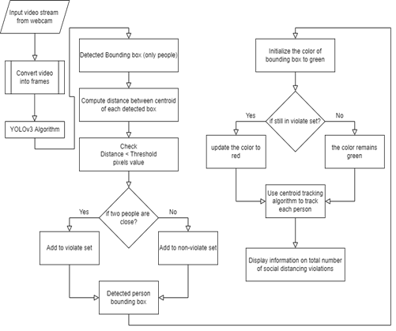
METHODOLOGY
Flowchart for Social Distance Detection

Slide 10
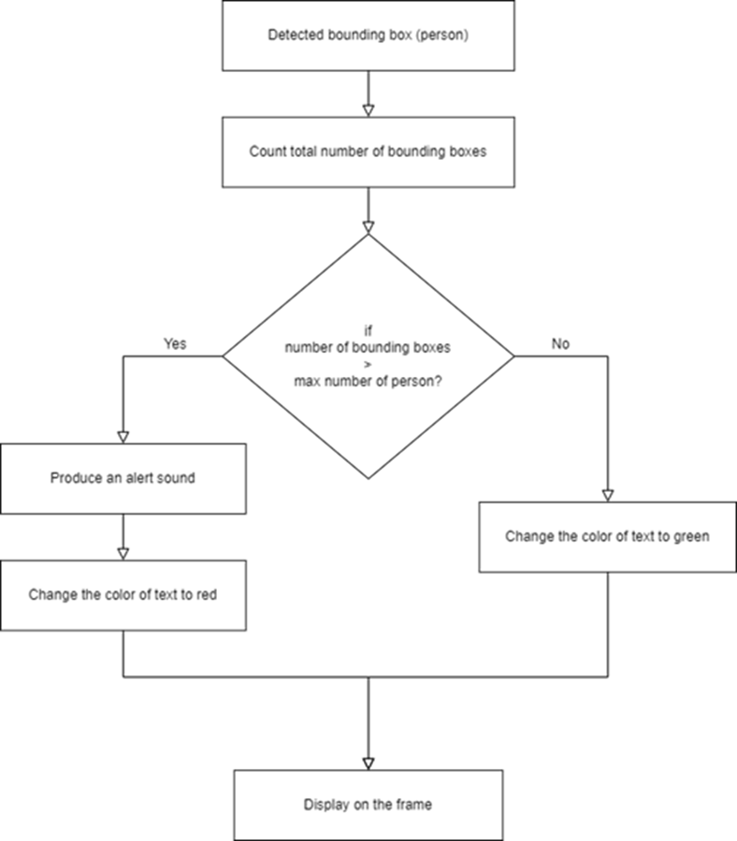
METHODOLOGY
Flowchart for Human Count

Slide 11
IMPLEMENTATION
The model is originally trained on the Common Objects in Context (COCO) dataset. For the detection of people with aerial view, transfer learning is implemented to improve the efficiency of the detection model for top view.
After detection, bounding box information, mainly centroid information, is used to calculate the centroid distance of each bounding box.
We use the Euclidean distance and calculate the distance between each bounding box of the detected city.
In the output, the model displays information on the total number of social distancing violations along with the people detected in the bounding boxes and centroids.

Slide 12
IMPLEMENTATION
Camera Placement for optimal functionality
Install camera 8-10 feet from the ground.
Point camera away from the sun.
Installing the camera at a high vantage point, angled slightly downwards as pointing the lens down slightly allows it to focus on objects while providing greater capture angle of the area.
Why not to position camera at eye level?
Placing the camera at eye level will reduce the camera’s angle of view thereby capturing smaller surrounding area.

Slide 13

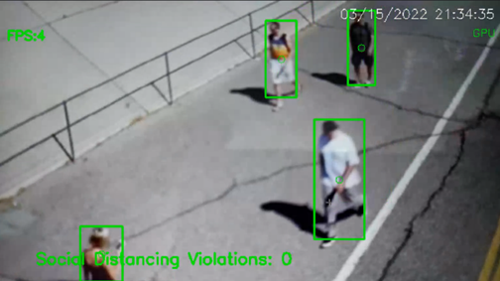
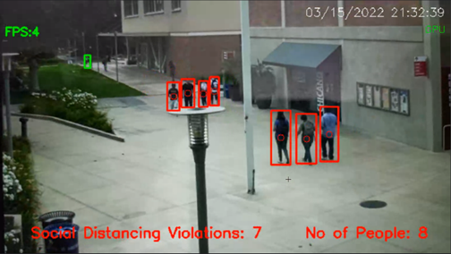
The results of the Social Distance Framework test were visualized with a pre-trained model.
The test results are evaluated using various video sequences.
The people in the video footage move freely in the scenes. The size of the person also varies in different places.

Slide 14
Since the model only takes into account the human class (person); therefore, only a human-like object will be recognized by a previously trained model.
The pre-trained model performs well and recognizes the bounding boxes of people of different sizes with green rectangles.
In the example boxes from, people are marked with green rectangles because they meet a social distancing threshold.
The model has also been tested by multiple people, as shown by multiple people entering the scene

Slide 15

Average Accuracy of Social Distance model is 94.5%

Slide 16
CONCLUSION
A methodology is proposed to detect social distancing through a deep learning model.
Computer vision can estimate the distance between people and any non-compliant pair of people shown with a red frame and line.
The results of the visualization showed that the proposed method can determine measures of social distancing between people that can be further developed for use in other environments such as the office, restaurant and school.
The work can be further improved by optimizing the pedestrian detection algorithm such as mask detection and body temperature detection.

Slide 17
REFERENCES
Centers for Disease Control (CDC). Implementation of Mitigation Strategies for Communities with Local COVID-19 [Online]. Available at: https://www.who.int/emergencies/diseases/novel-coronavirus-2019 (Accessed 8 May 2020).
Centers for Disease Control (CDC). Implementation of Mitigation Strategies for Communities with Local COVID-19 Transmission [Online]. Available at https://www.cdc.gov/coronavirus/2019-ncov/downloads/community-mitigation-strategy.pdf (Accessed 8 May 2020).
Ministry of Health Malaysia (MOHM) Official Portal. COVID-19 (Guidelines) [Online]. Available at (Accessed 8 May 2020).
D.T. Nguyen, W. Li, P.O. Ogunbona, “Human detection from images and videos: A survey”, Pattern Recognition, 51:148-75, 2016.
A. Krizhevsky, I. Sutskever, G.E. Hinton, “Image net classification with deep convolutional neural networks”, In Advances in neural information processing systems, pp. 1097-1105, 2012.
R. Girshick, J. Donahue, T. Darrell, J. Malik. "Rich feature hierarchies for accurate object detection and semantic segmentation." In Proceedings of the IEEE conference on computer vision and pattern recognition, pp. 580-587. 2014.
J. Redmon, S. Divvala, R. Girshick, A. Farhadi, “You only look once: Unified, real-time object detection”, In Proceedings of the IEEE conference on computer vision and pattern recognition, pp. 779-788.2016.
Landing AI Creates an AI Tool to Help Customers Monitor Social Distancing in the Workplace [Online]. Available at: https://www.landing.ai/landing-ai-creates-an-ai-tool-to-help-customersmonitor-social-distancing-in-the-workplace (Access on 4 May 2020).

Slide 18
SWOC ANALYSIS
Strength - Since non-maxima suppression is used the weak detections can be minimized.
Weakness - Need of system resources is more and graphics card is required.
Opportunity - This system can be deployed on the field for helping community against pandemic.
Challenge - While using mobile camera there is slight delay in the feed.

Slide 19


